Slide 1

Codergirl – WebDev Unit
Class 5
March 31, 2020
Notes:
1

Slide 2
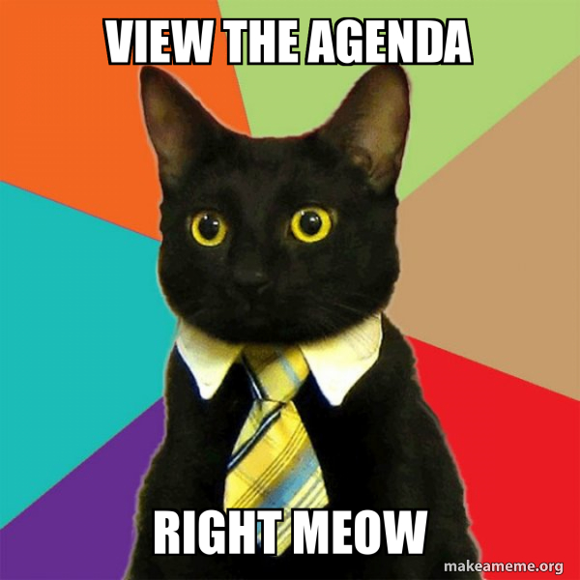
Agenda
Studio Review
Housekeeping
Review
Exercises
Studio
Notes:
2

Slide 3
Studio Review
Notes:
3

Slide 4
Housekeeping
Graded Assignment #1
DUE BEFORE CLASS WEDNESDAY
Notes:
4

Slide 5
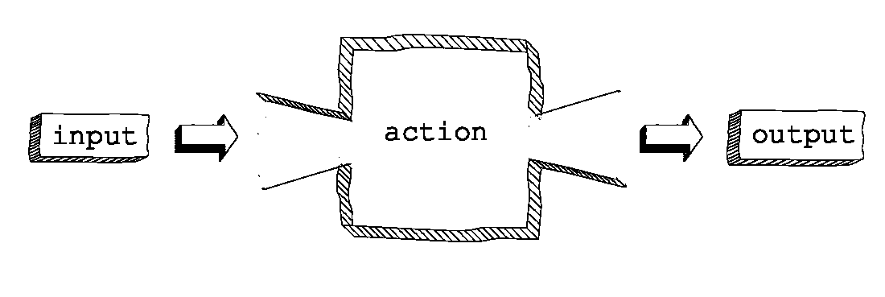
Review - Functions
Reusable piece of code
“Should do exactly one thing.”
Function Machine
Notes:
5

Slide 6
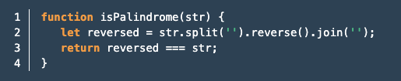
Review – Parts of a Function
Name
Parameters
Return
Notes:
6

Slide 7
Review – Naming functions
camelCase
buildRocketShip() – Good
build_rocket_ship() – Bad
User verb/noun pairs
getGamesPlayed() – Good
games() – Bad
Be descriptive!
updateUserDatabase() – Good
runUpdate() – Bad
Notes:
7

Slide 8
Review – Why use functions?
Reduce Repetition
We want our code DRY
Increase Readability
Reduce Complexity
More modular/easier to reuse
Notes:
8

Slide 9
Review – Functions
Questions?
Notes:
9

Slide 10

Live Coding
Notes:
10

Slide 11
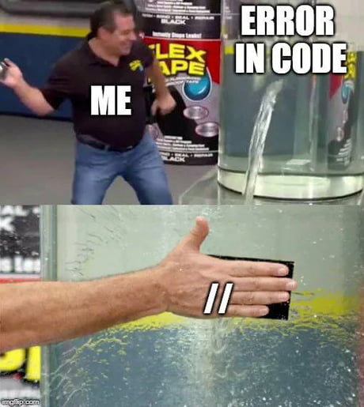
Now
Find your group Zoom
Studio
Graded Assignment
Prep for next week
Notes:
11

